Slide 1

NI
Lecture
Networking Infrastructure
Network Troubleshooting Techniques
5
Networking Infrastructure
Diploma in CSF / IT
Year 2 (2022/23), Semester 3
Notes:
Left-hand Bar – Replace FSP by your module code and X by the lecture number.
Replace Lecture Title
Replace < Module Name >
Replace Year and Semester if necessary

Slide 2
Objectives
Identify the various tools for troubleshooting a TCP/IP network;
Understand the functions of these tools;
Explain how these tools are used to troubleshoot a TCP/IP network.

Slide 3
Overview Of Network Troubleshooting Tools
ipconfig
ping
tracert
nslookup - Domain names
Netstat - open ports and services connected
telnet
SSH
route print - Print out routing table

Slide 4
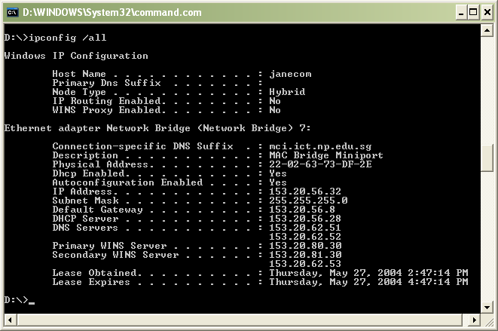
1. ipconfig
Used to display information about a computer’s addressing and connectivity parameters.

Slide 5
1. ipconfig
Provides the necessary information about the computer network.
Common options are:
/all
Display detailed information.
/release all
Release all adapters.
/renew all
Renew all adapters.
/release N
Release adapter N.
/renew N
Renew adapter N.

Slide 6
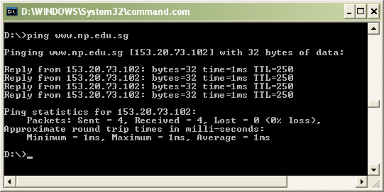
2. Ping
Tests whether another host on a TCP/IP network is reachable.
Round trip times are reported when Ping is used to provide an indication as to how long it takes to move information between the sender and the receiver.

Slide 7
3. Tracert
Facilitates a user to know the route that the IP packets travelled from one router to another.
Tracert also measures a packet’s round trip time by sending ICMP echo messages to a destination host.
sends packets in sets of three. Each time a sender sends a packet to a destination host, the destination host decrease the packet’s Time-To-Live (TTL) value by one.

Slide 8
3. Tracert
For example
The sending host sets the first three packets’ TTL field to 1.
The first router will ‘kill’ the packet by decrementing their TTLs to 0 and sends back to the sender an ICMP response Message Type 11.
The sender sets the TTL field of the second set to 2. The first router decrements each packet’s TTL by one and forwards it to the next router.
The second router sets the TTLs to 0 and sends a response saying TTLs have been exceeded.

Slide 9
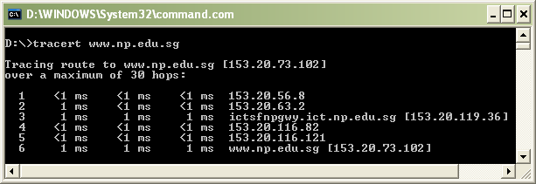
3. Tracert
This procedure continues until the sending host contacts the destination IP address, or the maximum hop count of 30 is reached.
This allows the Tracert program to determine which routers a packet goes through from the source to its destination.
Notes:
Refer to tracert used in Static and Dynamic Routing practicals.

Slide 10
4. nslookup
Name Server Lookup (nslookup)
Tool for querying the Domain Name System (DNS) to obtain
Domain name mapping
IP address mapping
Other DNS records
Troubleshooting DNS related problems
2 modes:
Noninteractive e.g. nslookup facebook.com
Interactive

Slide 11
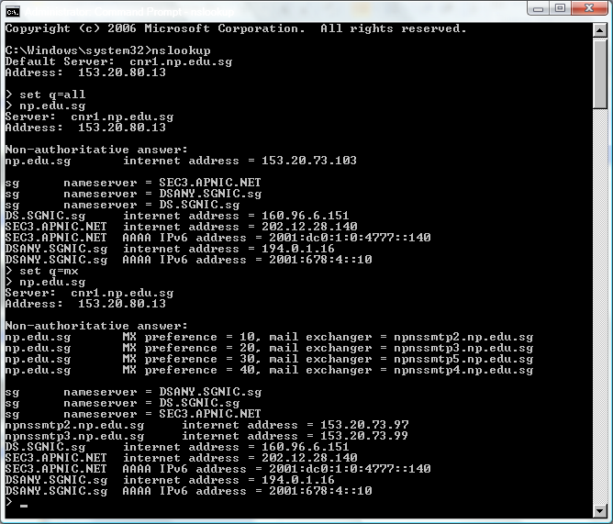
4. nslookup – interative mode

Slide 12
4. nslookup – interative mode
Identify the following from the screen capture from the previous slide
IP addresses and the Name server in domain np.edu.sg
IP addresses and names of the mail servers in domain np.edu.sg

Slide 13
5. netstat
netstat (network statistics) displays TCP network connections (both incoming and outgoing), routing tables, and a number of network interface statistics.
Notes:
netstat : Displays all active TCP connections on which the computer are using
netstat –r : Displays the contents of the IP routing table. This is equivalent to the route print command.
netstat –e : Displays Ethernet statistics, such as the number of bytes and packets sent and received

Slide 14
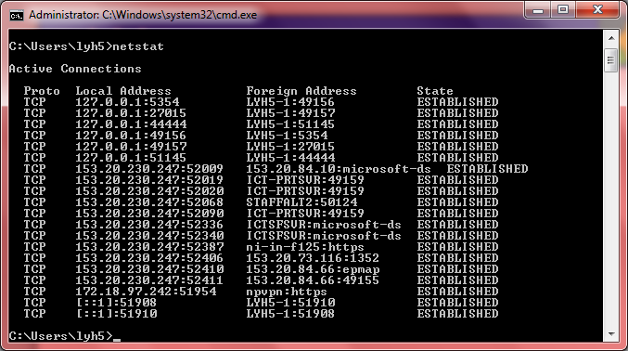
5. netstat
Notes:
Local Address - source IP address (or hostname) : source port number
Foreign Address - destination IP address (or hostname) : destination port number

Slide 15
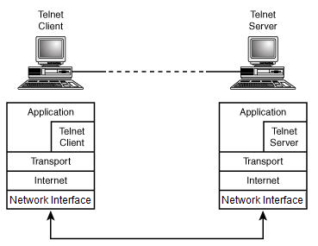
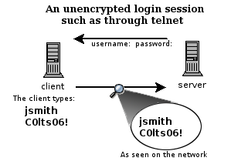
6. Telnet
Telnet is an application layer protocol used on the Internet or local area networks to accessing remote computers.
Through Telnet, an administrator or another user can access someone else's computer or server remotely.
A Telnet session is unencrypted, it can be viewed by anyone on the network by using a sniffing program, such as Wireshark

Slide 16
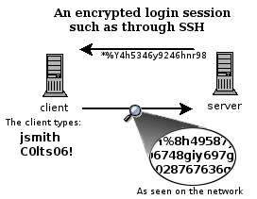
7. SSH
Secure Shell, or SSH, is an encrypted network protocol to allow remote login and other network services to operate securely over an unsecured network.
SSH was designed as a replacement for Telnet.
Notes:
SSH is widely used by network administrators for managing routers, firewalls and Unix/Linux hosts remotely over the network.

Slide 17
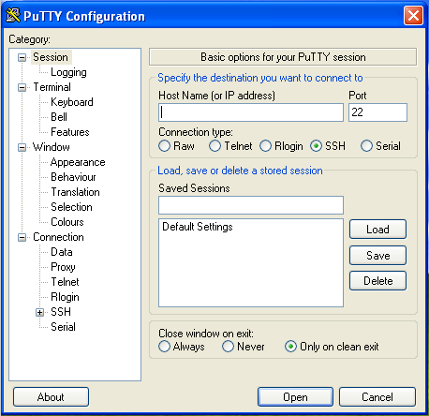
7. SSH
To use SSH on Windows, you have to download an SSH client. PuTTY is one of the best and freely available clients.

Slide 18
8. route print
The 'route print' Command from an Administrative Command Prompt in Windows OS provides a variety of useful information:
• Interface List
• IPv4 Route Table
• IPv6 Route Table

Slide 19
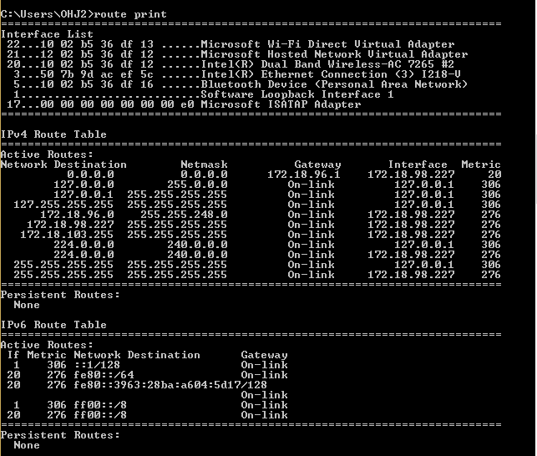
8. route print
Notes:
What is persistent route?
Creating Persistent (Static) Routes. You use the route command to manually manipulate the network routing tables. ... Using the route command is the only way that you can manually make routes persistent across system reboots

Slide 20
Summary
ipconfig
ping
tracert
nslookup
netstat
telnet
SSH
route print

